Slide 1
AI Ops Ninja
AI Ops Ninjas bridge Monitoring, Automation, and AI into one solution.
25/04/2026

Slide 2
Problem Statement : Inefficient, inconsistent, and slows incident response due to manual MS workflows.
Solution Statement: which automatically retrieves recent logs, performs intelligent analysis, and enriches Jira tickets with contextual summaries, root cause insights, and recommended actions streamlining incident management and reducing resolution time

Slide 3
Overview:
We implemented New Relic as the monitoring solution to continuously track website availability. When an issue is detected, New Relic triggers an alert based on predefined conditions, which automatically creates an incident ticket in Jira. The incident details are then forwarded to an Azure Function via a webhook, serving as the central orchestration and processing layer.
To investigate the incident, the Azure Function retrieves data from multiple Azure services used in our dummy model. The Azure Web App supplies client application data, while the Azure Log Analytics Workspace captures and analyzes application logs to detect errors and anomalies. This consolidated information is processed by the Azure Function and automatically posted as comments on the Jira ticket using Jira’s POST APIs.
In addition, log data from the Log Analytics Workspace is sent to AI Foundry, which generates an AI‑powered summarized incident report by converting raw technical logs into clear, actionable insights. This AI‑generated summary is also attached to the Jira ticket, enabling faster analysis, improved clarity, and quicker incident resolution.

Slide 4
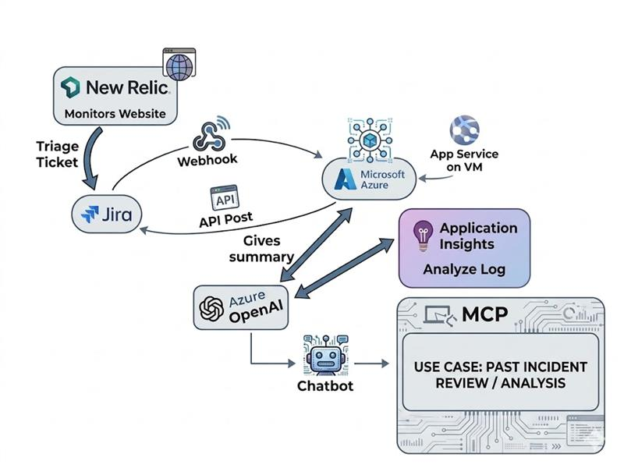
System Architecture

Slide 5
Incident flow
New Relic detects outage
Alert triggers Jira incident
Webhook (jira functionality) sends data to Azure Function
Logs and app data fetched
Add comments on ticket
AI Foundry generates summary report
Jira ticket enriched automatically

Slide 6
Demo Video Please click the link for Demo video:
Hack-Done.webm

Slide 7
Security & Access : Atlassian login creds: Email: h60562868@gmail.com Password: Hackathon@123456789

Slide 8
What Makes Our Solution Stand Out :
- Seamless integration of New Relic, Jira, Azure, and AI
- Centralized processing using Azure Functions
- AI‑powered incident summaries enhance clarity and decision‑making
- Real‑world applicability using monitoring and ITSM tools

